Slide 1
AI: Introduction
Course Code: CSC4226
Course Title: Artificial Intelligence and Expert System
Dept. of Computer Science
Faculty of Science and Technology
Lecture No: | Theory-01 | Week No: | 1 | Semester: | Spring: 2025-26
Professor: | Dr. Firoz Ahmed Mail: fahmed@aiub.edu

Slide 2
About Me
Dr. Firoz Ahmed
Professor
Department of Computer Science
Mail: fahmed@aiub.edu
Research Interest
Artificial Intelligence
Machine Learning
Deep Learning
Internet of Things (IoT)
Mobile Ad Hoc Networks (MANETs)
Wireless Sensor Networks (WSNs)

Slide 3
Lecture Outline
Vision and Mission
Course Evaluation
Class Policies
About the Course
What is AI?
The Foundations of AI.
Brief History of AI
Course Outline by Topics and Weeks.

Slide 4
Vision & Mission of AIUB
Vision
AMERICAN INTERNATIONAL UNIVERSITY-BANGLADESH (AIUB) envisions promoting professionals and excellent leadership catering to the technological progress and development needs of the country.
Mission
AMERICAN INTERNATIONAL UNIVERSITY-BANGLADESH (AIUB) is committed to provide quality and excellent computer-based academic programs responsive to the emerging challenges of the time
It is dedicated to nurture and produce competent world class professional imbued with strong sense of ethical values ready to face the competitive world of arts, business, science, social science and technology.

Slide 5
Goals of AIUB
Sustain development and progress of the university
Continue to upgrade educational services and facilities responsive of the demands for change and needs of the society
Inculcate professional culture among management, faculty and personnel in the attainment of the institution's vision, mission and goals
Enhance research consciousness in discovering new dimensions for curriculum development and enrichment
Implement meaningful and relevant community outreach programs reflective of the available resources and expertise of the university
Establish strong networking of programs, sharing of resources and expertise with local and international educational institutions and organizations
Accelerate the participation of alumni, students and professionals in the implementation of educational programs and development of projects designed to expand and improve global academic standards

Slide 6
Vision & Mission of CS Dept.
Vision
Provides leadership in the pursuit of quality and excellent computer education and produce highly skilled and globally competitive IT professionals.
Mission
Committed to educate students to think analytically and communicate effectively; train them to acquire technological, industry and research-oriented accepted skills; keep them abreast of the new trends and progress in the world of information communication technology; and inculcate in them the value of professional ethics.

Slide 7
Goals of CS Department
Enrich the computer education curriculum to suit the needs of the industry- wide standards for both domestic and international markets
Equip the faculty and staff with professional, modern technological and research skills
Upgrade continuously computer hardware's, facilities and instructional materials to cope with the challenges of the information technology age
Initiate and conduct relevant research, software development and outreach services.
Establish linkage with industry and other IT-based organizations/institutions for sharing of resources and expertise, and better job opportunities for students

Slide 8
Course Evaluation
Mid Term | Class Quizzes | 20
 | Laboratory Performance/Viva/Exam | 20
 | Class Attendance/Performance | 10
 | Midterm Written Exam | 50
 | Mid Term Total | 100 | 40%
Final Term | Class Quizzes | 20
 | Laboratory Performance/Viva/Exam | 20
 | Class Attendance/Performance | 10
 | Final Written Exam | 50
 | Final Term Total | 100 | 60%
Grand Total | Final Grade of the Course |  | 100%

Slide 9
Classroom Policies
Must be present inside the class in due time.
Class Break: I would prefer to start the class in due time, giving a break 5/10 minutes. and leave the class in 5/10 minutes early for theory/Laboratory class respectively
Every class will start with a question-answer session about the last lecture. So, students must be prepared with the contents and exercises from the last lecture.
Students are suggested to ask questions during or after the lecture.
Late in Class:
  Student coming after 10 minutes of due time is considered late.
  1 late attendances are considered as one absent.
  Late during quiz is not given additional time.
  Students who are regularly late might have additional deduction of marks.
  A late student will be allowed to enter the class.
  Don’t ask permission to enter the class, just get in slowly and silently.
  To leave class you will need to ask for permission.

Slide 10
Attendance
At least 80% presence is required by the student. Absent classes must be defended by the student through application and proper documentation to the course teacher.
Long absences/irregular presence/absences out of 25% range must go through application procedures via department Head (+ probation office, if student is in probation) to attend the following classes.
Acceptance of an application for absence only gives permission to attend the following classes. This might still result in deduction of marks (for attendance) which will be judged by the course teacher.

Slide 11
Grading Policies
All the evaluation categories & marks will be uploaded to the VUES within one week of the evaluation process except the attendance & performance, which will be uploaded along with the major (mid/final term) written exam marks.
Letter grades ‘A+’ through ‘F’ is counted as grades. Other grades ‘I’ and ‘UW’ are considered as temporary grades which are counted/calculated as ‘F’ grade in the CGPA. These grades must/will be converted to the actual grades, i.e. ‘A+’ through ‘F’.
‘I: INCOMPLETE’ is given to students who have missed at most 30% of evaluation categories (quiz/assignment/etc.). Students must contact the course teacher for makeup, through valid application procedures immediately after grade release.
‘UW: UNOFFICIAL WITHDRAW’ is given when the missing evaluation categories are too high (more than 30%) to makeup. A student getting ‘UW’ has no option but to drop the course immediately after grade release

Slide 12
Grading Policies…
Once a student’s gets ‘I’ or ‘UW’ and unable to fulfill the requirements with the course teacher for makeup, must drop the course within officially mentioned time period from the registration department.
Students in probation or falls into the probation due to ‘I’/’UW’ grade are not allowed to drop the course.
Unable to do so will result in the automatic conversion of the grades ‘I’/’UW’ to ‘F’ grade after the 4th week of the following semester.
Any problem with the mark/grade must be consulted with the course teacher within one week of the release of grades.

Slide 13
Dropping Course
Must fill up the drop form and get it signed by the course teacher, write an application to the vice chancellor and get it signed by the department Head, and finally submit the form & application to the registration department.
The course teacher must write down the grades (if any) obtained in midterm, final, and grand total on the drop form.
No drop is accepted during the following periods:
  One week before midterm exam – grade release date of midterm exam.
  One week before final term exam – grade release date of final grade.
Student with ‘F’ grades in midterm, final term, or grand total cannot drop.
Probation student are not allowed to drop any course.

Slide 14
Contacts
Contact information (email, Teams, office location, consulting hours, etc.) of the course teacher must be stored by the students.
It is mandatory to contact/notify (preferably consulting hour/email) the course teacher for/of any problems/difficulties at the earliest possible. Late notification might not be considered.
Update & correct your email address & phone number at VUES, as the teacher will contact/notify you of anything regarding the course through these information in VUES.

Slide 15
Finally
For any problems that could not be solved/understood during the lecture, students are advised to contact during the consultation hours and solve the problem
Any kind of dishonesty, plagiarism, misbehavior, misconduct, etc. will not be tolerated. Might result in deduction of marks, ‘F’ grade, or reported to the AIUB Disciplinary Committee for drastic punishment
Always check/visit the AIUB home page for notices, rules & regulations of academic/university policies and important announcement for deadlines (Course drop, Exam permit, Exam Schedule, etc.).

Slide 16
Course Prerequisite
Representing information in computers, Binary Number Systems, Conversions.
Programming Languages (C/C++/Python)
Using C/C++/Python editors, debugging (Colab)
Data Storage Concept & Data types in Programming languages,
Variable, Array (single & multidimensional), String, List, Dictionaries
Functions, Scope of variable & function
Design and Analysis of Algorithms

Slide 17
Course Objective
Get an overview of artificial intelligence (AI) principles and approaches.
Develop a basic understanding of the building blocks of AI as presented in terms of intelligent agents: Search, Knowledge representation, inference, logic, learning.
Develop a brief overview of AI applications: Expert Systems and Planners.
Follow AI literature with the ability to go on to independent work in the field.

Slide 18
Importance of the course
Studying artificial intelligence opens a world of opportunities
At a basic level, you’ll better understand the systems and tools that you interact with daily. And if you stick with the subject and study more, you can help create cutting edge AI applications, like the Google Self Driving Car, or IBM’s Watson
In the field of artificial intelligence, the possibilities are truly endless
Studying AI now can prepare you for a job as a researching neural networks, human-machine interfaces, and quantum artificial intelligence.
Or you could work as a software engineer in industry working for companies like Amazon to shopping list recommendation engines or Facebook analyzing and processing big data.
You could also work as a hardware engineer developing electronic parking assistants or home assistant robots

Slide 19
Course Content
Introduction to Artificial Intelligence
Intelligent Agent
Problem Solving, Search and Control Strategies
Knowledge Representation Issues, Predicate Logic, Rules
Reasoning System: Symbolic, Statistical
Learning Systems
Expert System
Neural Networks: Fundamental
Genetic Algorithms: Fundamental

Slide 20
What is Artificial Intelligence ?
“Can Machine think”

Slide 21
What is Artificial Intelligence ?
Artificial Intelligence is composed of two words
Artificial and Intelligence
where Artificial defines "man-made," and
intelligence defines "thinking power“
Hence AI means "a man-made thinking
So, we can define AI as:
  "It is a branch of computer science by which we can create intelligent machines which can behave like a human, think like humans, and able to make decisions." power.“
  Artificial Intelligence exists when a machine can have human based skills such as learning, reasoning, and solving problems

Slide 22
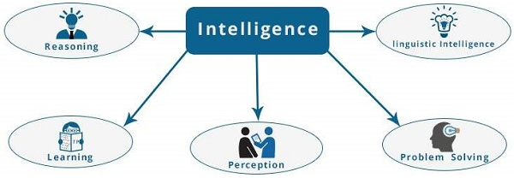
What is Artificial Intelligence ?
  Intelligence is composed of:
    Reasoning
    Learning
    Problem-Solving
    Perception
    Linguistic Intelligence
According to the father of Artificial Intelligence, John McCarthy
  “It is the science and engineering of making intelligent machines, especially intelligent computer programs”.

Slide 23
What is Artificial Intelligence ?
Artificial Intelligence suggest that machines can mimic humans in
  Talking
  Thinking
  Learning
  Planning
  Understanding
Artificial Intelligence is also called Machine Intelligence and Computer Intelligence.Key Goals of AI
  Mimic human intelligence
  Learn from experience (data)
  Adapt to new inputs
  Make rational decisions

Slide 24
What is Artificial Intelligence ?
Core Areas of AI
  Machine Learning (ML): Systems learn from data
  Deep Learning: Neural networks with many layers
  Natural Language Processing (NLP): Understanding human language
  Computer Vision: Interpreting images and videos
  Robotics: Intelligent physical agents
  Expert Systems: Decision-making based on rules and knowledge

Slide 25
What is Artificial Intelligence ?
Applications of AI
  Healthcare (disease diagnosis)
  Education (intelligent tutoring systems)
  Finance (fraud detection)
  Transportation (self-driving cars)
  Cybersecurity
  Agriculture and smart cities
Importance of AI
  AI improves efficiency, accuracy, and automation, helping solve complex real-world problems and shaping the future of technology.

Slide 26
Goal of AI
To Create Expert Systems −
  The systems which exhibit intelligent behavior, learn, demonstrate, explain, and advice its users.
To Implement Human Intelligence in Machines −
  Creating systems that understand, think, learn, and behave like humans.

Slide 27
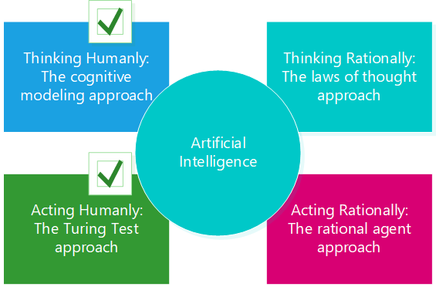
AI Approaches
Artificial Intelligence can be approached in four main ways, based on how intelligence is defined and measured:

Slide 28
AI Approaches
Thinking Humanly (Cognitive Modeling Approach)
  This approach tries to model the human thought process.
  Based on:
    Psychology
    Cognitive science
    Brain modeling
  Example: Cognitive architectures like ACT-R
Thinking Rationally (Laws of Thought Approach)
  This approach emphasizes logical reasoning to reach correct conclusions.
  Uses:
    Formal logic
    Mathematical reasoning
  Limitation: Not suitable for uncertainty and incomplete information.

Slide 29
AI Approaches
Acting Humanly (Turing Test Approach)
  This approach focuses on making machines behave like humans.
  Requirements:
    Natural Language Processing
    Knowledge Representation
    Automated Reasoning
    Machine Learning
    Computer Vision & Robotics (for total Turing Test)
  Example: Chatbots, virtual assistants
Acting Rationally (Rational Agent Approach-Mostly Used)
  This approach focuses on agents that take actions to maximize goal achievement.
  Characteristics:
    Perceive environment through sensors
    Act through actuators
    Choose optimal actions
  Example: Autonomous robots, self-driving cars

Slide 30
Types of AI
Major Types of AI
Narrow AI (Weak AI): Designed for specific tasks
Examples: Voice assistants, recommendation systems
General AI (Strong AI): Can perform any intellectual task a human can (still theoretical)
Super AI: Exceeds human intelligence (conceptual/future)

Slide 31
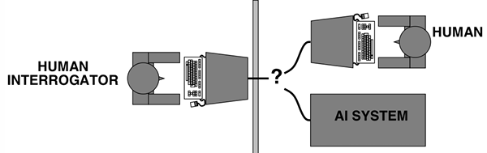
Turing Test
Turing Test
  The Turing Test was proposed by Alan Turing in 1950 to determine whether a machine can exhibit human-like intelligence.
Basic Idea
  A machine is said to be intelligent if a human evaluator cannot reliably distinguish between responses from the machine and a human during a conversation.
Test Setup
  One human judge
  One human
  One machine
Communication is done only via text (to avoid physical clues)
If the judge fails to identify the machine correctly, the machine

Slide 32
The Foundation of AI
Philosophy
Mathematics
Economics
Neuroscience
Psychology
Computer engineering
Control theory and cybernetics
Linguistics

Slide 33
Exercise
Describe the ‘Acting Humanly’ perspective for defining Artificial Intelligence.
Describe the Turing Test that can be used to test the ‘Acting humanly’ perspective.

